Slide 1




Why Alma...?
The Alma Value Proposition

Slide 2

Dvir Hoffman
Director, Product Management & Marketing

Slide 3

Architecture
The Current Resource Silos Challenges
    Duplicate
    Data
Print
Materials
Electronic
Materials
Digital
Materials
    Duplicate Workflows
Silo 1
Silo 2
Silo 3
Notes:
I’d like to go in and talk about the architecture. We now have the model where everything is inventory based. The product holds inventory on anything that you own and we are going to track it. This is an example of how we can do amazing things with data that lives in the cloud. Specifically in this instance, it exists within the community zone. The community zone is the data that you own that is local to your library. In the data services zone we have the ckb. For those of you that have metalib you will understand what this is. We have had years of building the ckb. The community catalog will be populated with lc and blc and we have the global authorities file that will be seeded from or linked to the lc global authority file and mesh. We’re also looking at other relationships with other international authority files and some art vocabularies. In general release it will be LC and mesh. So how does this work?
A library purchases the trial and uses present day processes to pull in metadata. So this can be from oclc, it can be from ybp, and the inventories then attach to that metadata. The library purchases the collapse. Alma checks the community zone for metadata that would work for this version of the collapse. It will, or one can, attach ones inventory to that record. What’s great about that is while this record is enhanced by the community, the enhancement happens automatically. When one activates the package from academic search premier from EBSCO, Alma knows what title exists within that package and also understands the current data.
So as EBSCO adds 15 titles, Alma takes care of that automatically. There is no longer the updating of knowledge bases every 2 weeks. No longer the need to tell if a record has been turned on—it happens automatically within the product. And then also with authorities—updated automatically. Because authority work is so difficult and tedious, some institutions do it every two months and spend 3 or 4 days checking authorities and grouping authorities—no longer necessary. It is done automatically. If an authority record is changed in lc it will be populated in Alma automatically. This is a form of linked data. What’s cool about this is say something in the next couple weeks happens in the news, and an authority record changes. The authority record changes in lc, it goes to Alma, and filters to any record in the community zone, catalog, or local record. The only time there is an interaction with a librarian is if there is a split in the record. If it requires a choice. In this case, the system tells a librarian it needs to be done by their role. It would be pushed to their task list. I’ll talk about this more as I get into the demo.
One thing I like to do here is mention that Alma, a URM, is a back office tool. It is not an ILS. It is next gen library services. It encompasses everything the library needs to do to watch over and run their inventory. It is not an opac nor does it need one. It’s better than that. One simply places a discovery layer over Alma. We are saying that Alma is discovery layer agnostic, you can use any discovery layer you like, but also to be clear that our discover layer primo is being developed next to Alma and in many cases you have developers working on both sides. We will work as closely as we can to offer up API and web services to bring us close to the requirements for ILS DI. To go beyond that, though, primo will have the complete integration.

Slide 4


Architecture
Efficiency: Unified Resource Management
    Unified
    Data
Fulfillment
    Unified Workflows
Metadata Management
Acquisitions
    Unified Management
Selection
Notes:
I’d like to go in and talk about the architecture. We now have the model where everything is inventory based. The product holds inventory on anything that you own and we are going to track it. This is an example of how we can do amazing things with data that lives in the cloud. Specifically in this instance, it exists within the community zone. The community zone is the data that you own that is local to your library. In the data services zone we have the ckb. For those of you that have metalib you will understand what this is. We have had years of building the ckb. The community catalog will be populated with lc and blc and we have the global authorities file that will be seeded from or linked to the lc global authority file and mesh. We’re also looking at other relationships with other international authority files and some art vocabularies. In general release it will be LC and mesh. So how does this work?
A library purchases the trial and uses present day processes to pull in metadata. So this can be from oclc, it can be from ybp, and the inventories then attach to that metadata. The library purchases the collapse. Alma checks the community zone for metadata that would work for this version of the collapse. It will, or one can, attach ones inventory to that record. What’s great about that is while this record is enhanced by the community, the enhancement happens automatically. When one activates the package from academic search premier from EBSCO, Alma knows what title exists within that package and also understands the current data.
So as EBSCO adds 15 titles, Alma takes care of that automatically. There is no longer the updating of knowledge bases every 2 weeks. No longer the need to tell if a record has been turned on—it happens automatically within the product. And then also with authorities—updated automatically. Because authority work is so difficult and tedious, some institutions do it every two months and spend 3 or 4 days checking authorities and grouping authorities—no longer necessary. It is done automatically. If an authority record is changed in lc it will be populated in Alma automatically. This is a form of linked data. What’s cool about this is say something in the next couple weeks happens in the news, and an authority record changes. The authority record changes in lc, it goes to Alma, and filters to any record in the community zone, catalog, or local record. The only time there is an interaction with a librarian is if there is a split in the record. If it requires a choice. In this case, the system tells a librarian it needs to be done by their role. It would be pushed to their task list. I’ll talk about this more as I get into the demo.
One thing I like to do here is mention that Alma, a URM, is a back office tool. It is not an ILS. It is next gen library services. It encompasses everything the library needs to do to watch over and run their inventory. It is not an opac nor does it need one. It’s better than that. One simply places a discovery layer over Alma. We are saying that Alma is discovery layer agnostic, you can use any discovery layer you like, but also to be clear that our discover layer primo is being developed next to Alma and in many cases you have developers working on both sides. We will work as closely as we can to offer up API and web services to bring us close to the requirements for ILS DI. To go beyond that, though, primo will have the complete integration.

Slide 5

Unified by Design

Slide 6
Unified Architecture
Primo
Discovery
Delivery
Community zone
Alma
DATA SERVICES
Resource Management
Selection
Business Intelligence
and Analytics
Acquisitions
Cataloging
Fulfillment
Infrastructure
Cloud
Infrastructure
Security
Workflow
Engine
Open
Platform
Notes:
Alma is a unified resource management system, incorporating an exception-based workflow model to support the end-to-end management of print, electronic resources and local digital collections. Rather than integrating a range of existing, disparate services, Alma has been designed from the ground-up to break down the traditional silos between formats and create additional efficiencies to reduce the cost of ownership and provide additional bandwidth for library staff.
This approach enables for example:
Cross format Selection and acquisition as well as e-resource activation based on a single KnowledgeBase
Consistent workflows across formats
Metadata for e-resource titles available in the metadata management system
Link resolution built into the inventory
Usage, cost per use, and other tools to evaluate value of e-resources when making renewal or cancellation decisions
Single source for reporting

Slide 7
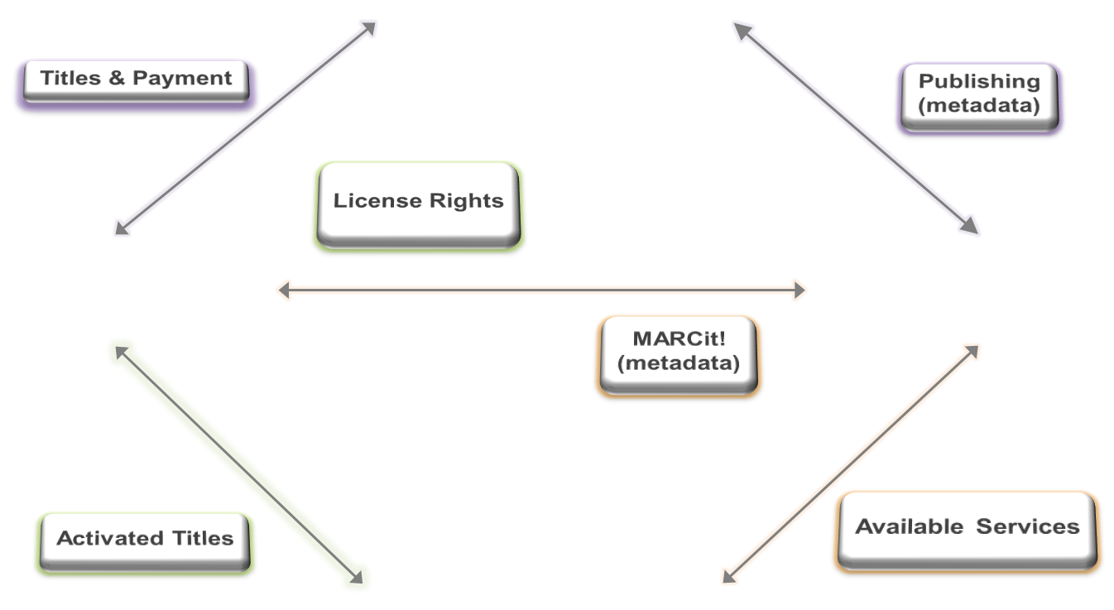
Managing e-Resources Without Alma
ILS
ERM
Discovery
ERM
Link Resolver
Notes:
One of the best examples of this is illustrated when you look at the changes Alma introduces for managing e-resources. Even for those of you who have an erms environment that is integrated with your ILS, the steps involved in managing e-resources across what are effectively separate systems – the ILS, the ERM and your link resolver – often requires a multiplicity of steps with staff handing off portions of the workflow across each of these 3 systems as they first select and acquire the resource,

Slide 8
Managing e-Resources with Alma
Real Case
BC
Total # of Separate Handoffs Required to Manage e-Resources
0
ERM
Alma
Link Resolver
ILS
Notes:
Contrast this to the unified management environment of Alma which requires NO handoffs between separate systems::
- selection, acquisition and activitation of electronic resources is based on a single Knowledgebase which is linked to metadata describing the resources
- The workflows for library staff are consistent with workflows for managing print resources, so not only do staff not need to use separate systems, there is also no need for staff to be familiar with different UI environments.
- Link resolution is built into Alma so libraries do not need to maintain a separate link resolved and many of the steps involving activation and publication of resources for discovery can be automated in Alma providing further efficiencies
- Because Alma is a unified service and includes a robust business intelligence and reporting tool, usage information and cost per use is easy to determine and can, in fact, be directly integrated into the staff workflow for evaluation ensuring more effective decision making.

Slide 9
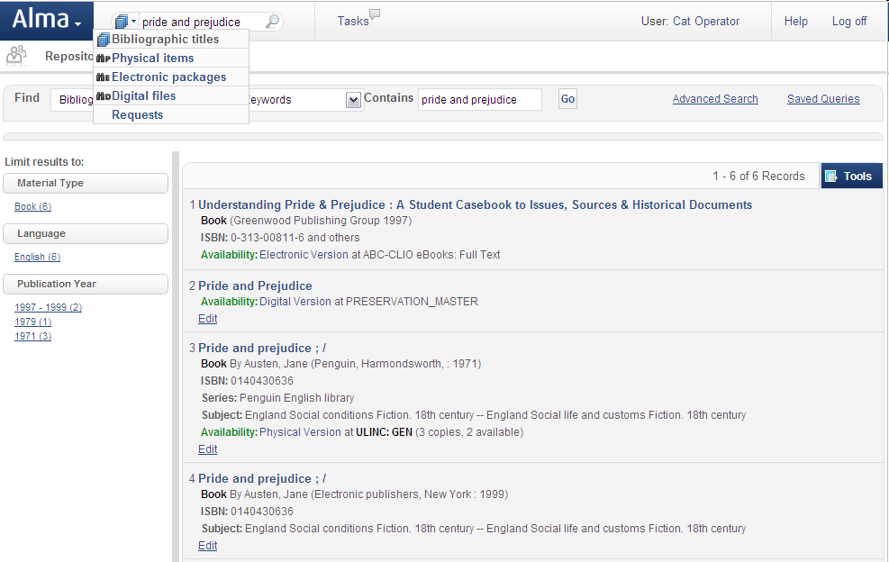
Single Search
Single search across all resource types
Resource types managed together
Notes:
Replaced with more updated screenshot

Slide 10

Architecture
The Alma Community Zone
The Alma Institution Zone
Global Authorities
Local Catalog
Community Catalog
Inventory
Hamlet
The Trial
Central KnowledgeBase
Academic Search Premier
Academic Search Premier
Notes:
I’d like to go in and talk about the architecture. We now have the model where everything is inventory based. The product holds inventory on anything that you own and we are going to track it. This is an example of how we can do amazing things with data that lives in the cloud. Specifically in this instance, it exists within the community zone. The community zone is the data that you own that is local to your library. In the data services zone we have the ckb. For those of you that have metalib you will understand what this is. We have had years of building the ckb. The community catalog will be populated with lc and blc and we have the global authorities file that will be seeded from or linked to the lc global authority file and mesh. We’re also looking at other relationships with other international authority files and some art vocabularies. In general release it will be LC and mesh. So how does this work?
A library purchases the trial and uses present day processes to pull in metadata. So this can be from oclc, it can be from ybp, and the inventories then attach to that metadata. The library purchases the collapse. Alma checks the community zone for metadata that would work for this version of the collapse. It will, or one can, attach ones inventory to that record. What’s great about that is while this record is enhanced by the community, the enhancement happens automatically. When one activates the package from academic search premier from EBSCO, Alma knows what title exists within that package and also understands the current data.
So as EBSCO adds 15 titles, Alma takes care of that automatically. There is no longer the updating of knowledge bases every 2 weeks. No longer the need to tell if a record has been turned on—it happens automatically within the product. And then also with authorities—updated automatically. Because authority work is so difficult and tedious, some institutions do it every two months and spend 3 or 4 days checking authorities and grouping authorities—no longer necessary. It is done automatically. If an authority record is changed in lc it will be populated in Alma automatically. This is a form of linked data. What’s cool about this is say something in the next couple weeks happens in the news, and an authority record changes. The authority record changes in lc, it goes to Alma, and filters to any record in the community zone, catalog, or local record. The only time there is an interaction with a librarian is if there is a split in the record. If it requires a choice. In this case, the system tells a librarian it needs to be done by their role. It would be pushed to their task list. I’ll talk about this more as I get into the demo.
One thing I like to do here is mention that Alma, a URM, is a back office tool. It is not an ILS. It is next gen library services. It encompasses everything the library needs to do to watch over and run their inventory. It is not an opac nor does it need one. It’s better than that. One simply places a discovery layer over Alma. We are saying that Alma is discovery layer agnostic, you can use any discovery layer you like, but also to be clear that our discover layer primo is being developed next to Alma and in many cases you have developers working on both sides. We will work as closely as we can to offer up API and web services to bring us close to the requirements for ILS DI. To go beyond that, though, primo will have the complete integration.

Slide 11
Multi-Schema Support

Slide 12
Cataloging
Primo
Discovery
Delivery
Community zone
Alma
DATA SERVICES
Resource Management
Selection
Business Intelligence
and Analytics
Acquisitions
Cataloging
Fulfillment
Infrastructure
Cloud
Infrastructure
Security
Workflow
Engine
Open
Platform
Notes:
Throughout the course of the presentation today, you will see the extensive functional capabilities available today with Alma. I wanted to take a few minutes and highlight just a few of the unique capabilities that our solution will provide.

Slide 13
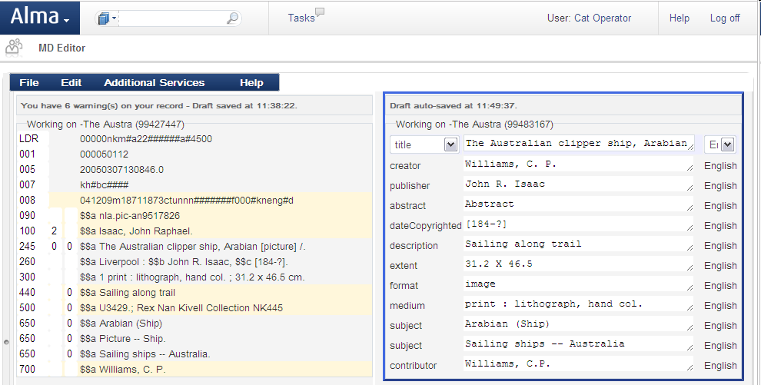
Metadata Management
Notes:
Alma has been designed to be metadata-agnostic and extensible. Today, Alma supports multiple metadata schemas including: MARC21 and Dublin Core with MODS planned for next year. Our support extends beyond the editing interfaces to also include field validation and contextual help. This facility provides Alliance members with a great way to describe your unique local collections according to your own needs.

Slide 14
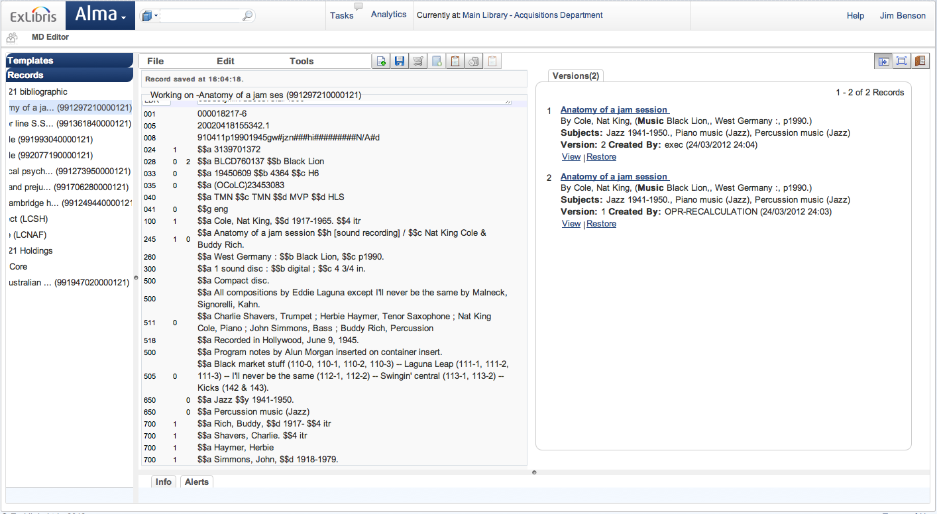
Metadata Management
Notes:
Alma also provides auto-save with record versioning and recovery options.

Slide 15
Real Use Case
Real Case
75% Reduction in Records Import Work
FHSU regularly imports MARC records as part of their cataloging workflow
Used Alma one-time setup for the import of the MARC with appropriate rules for validation, duplicate detection, normalization, etc.
75% of the work required with their traditional ILS eliminated due to the automation built into Alma.
A staff member at the library has called this: Alma working “AUTOmagically”.

Slide 16
Business Intelligence & Analytics

Slide 17
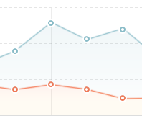
Analytics
Primo
Discovery
Delivery
Community zone
Alma
DATA SERVICES
Resource Management
Selection
Business Intelligence
and Analytics
Acquisitions
Cataloging
Fulfillment
Infrastructure
Cloud
Infrastructure
Security
Workflow
Engine
Open
Platform
Notes:
One of the fundamental elements of Alma’s design is the sophisticated and pervasive use of business intelligence and analytics capabilities

Slide 18
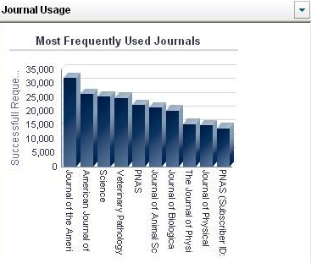
Analytics
Sophisticated analysis, informed decision making
Analytics data as part of daily work
Suite of industry-relevant report templates
Diverse customization options
Near real-time
Role-based
Operational and analytics
Customizable and intuitive
ARL reports
Notes:
These capabilities are embedded throughout the system and are designed to support informed decision making for library operations. In addition to industry standard and custom reports, analytics are delivered to staff based upon their role at the point of need within a given workflow and can also be displayed on the users Dashboard.

Slide 19
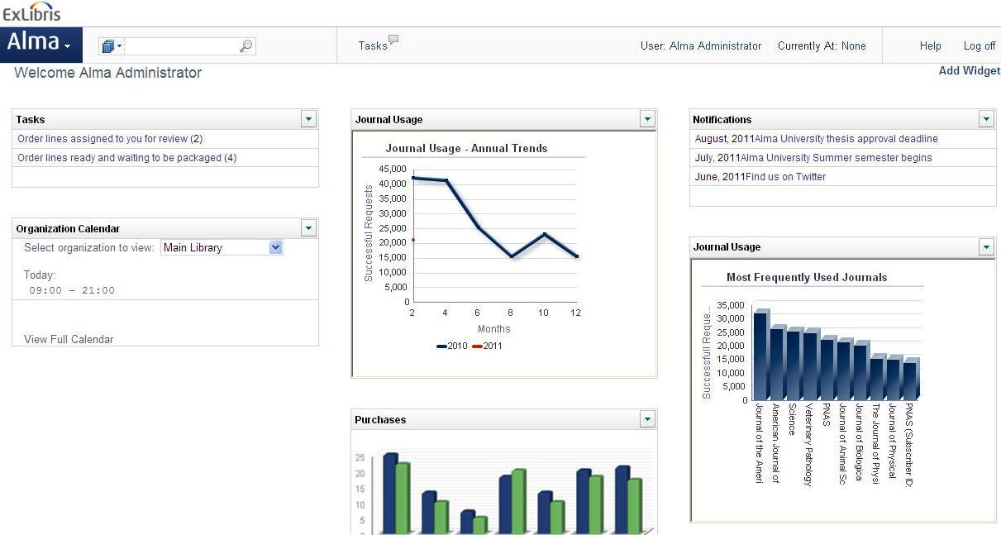
Analytics
Usage
Statistics
Notifications
Staff
Tasks
Library
Calendar
Notes:
ANALYTICS IN USER DASHBOARD
Alma home page is built as a configurable dashboard which displays a variety of elements, based on the user’s roles.
The elements are operational, like the notification section and the tasks sections. From the Tasks section the user is redirected to his specific list of tasks where he can trigger the relevant workflow.
Besides the operational section the user is presented with analytics according to common business logic and processes. In the first stage we are working on producing USTAT-like widgets which display the usage statistics of e-journals, in various dimensions, split by journals, periods, and number of requests. It is going to be presented by Barbara as part of our demos in ALA.
Adding a widget to the dashboard is simple and intuitive (demo).

Slide 20
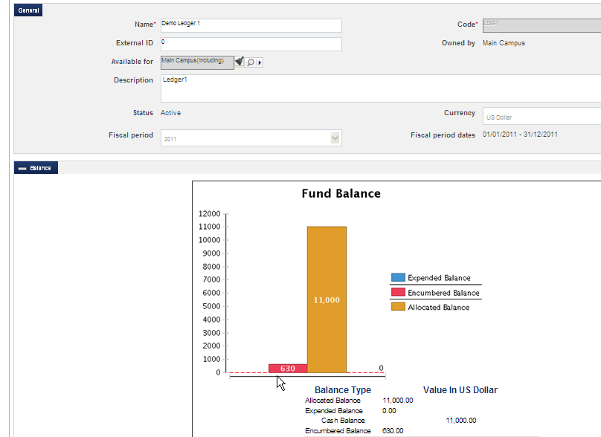
Funds
Expenditures vs. Allocations
Notes:
Analytics are also embedded directly within workflows throughout the system. For example, a staff operator working with funds can quickly and easily visualize fund balance, expenditures and allocation at a glance.

Slide 21
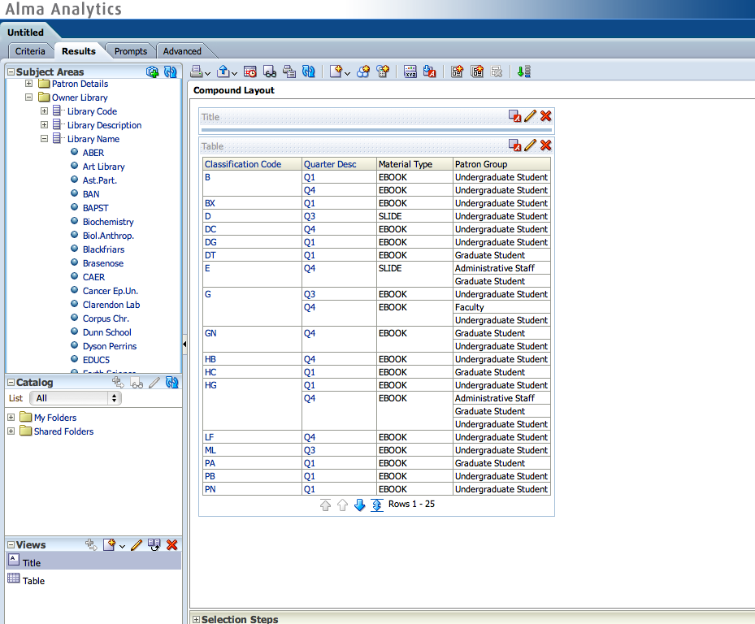
Analytics
Notes:
Alma Analytics also provides extensive capabilities for custom report creation through an easy-to-use web-based interface with drag-and-drop editing capabilities. Custom reports can be published in a variety of formats including through analytical widgets and distribution can be defined by role or limited to individual staff.

Slide 22
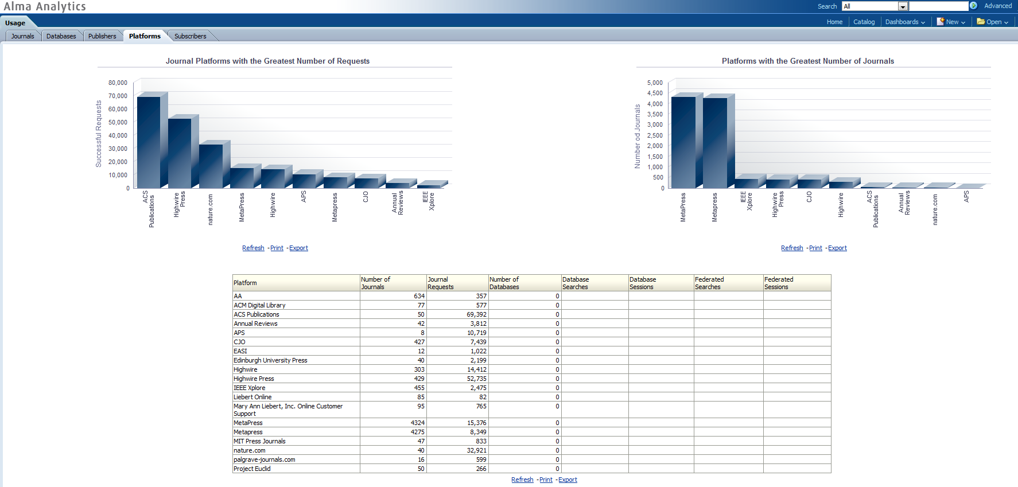
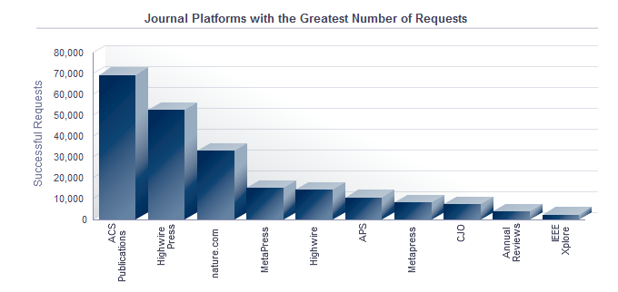
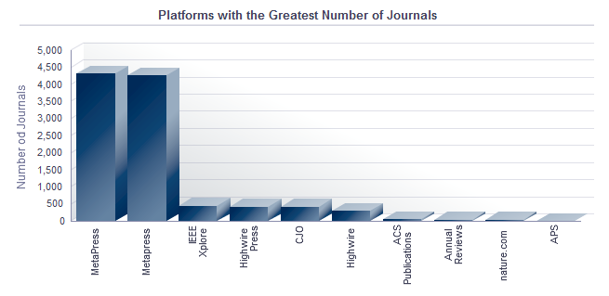
Usage Analysis

Slide 23
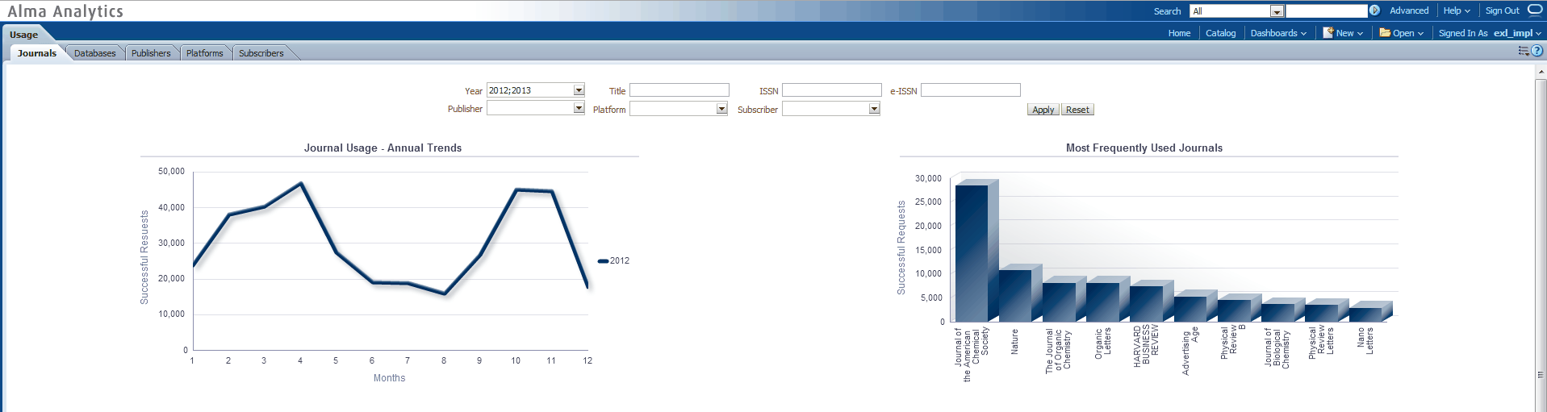
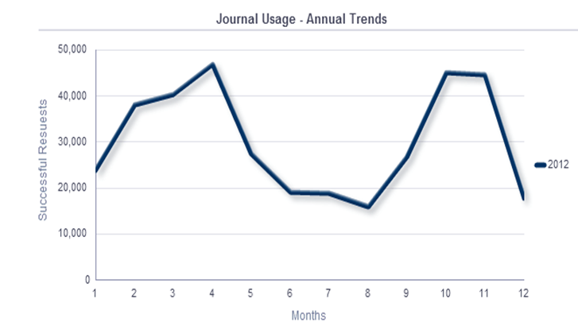
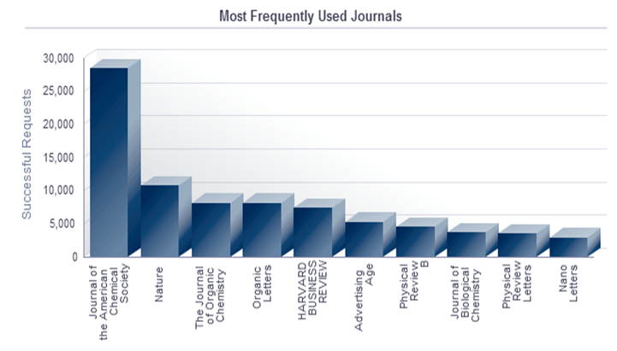
Usage Analysis

Slide 24
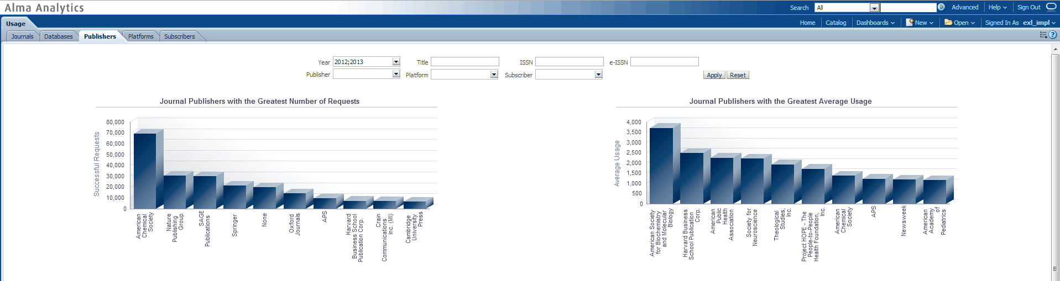
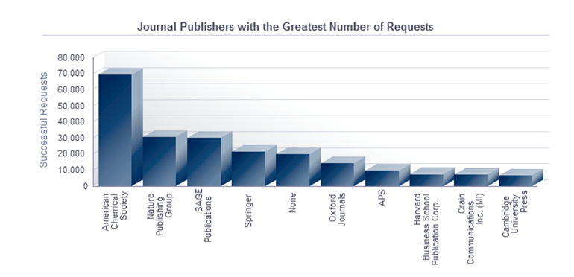
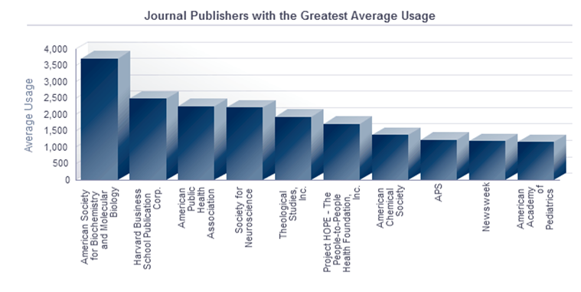
Usage Analysis

Slide 25
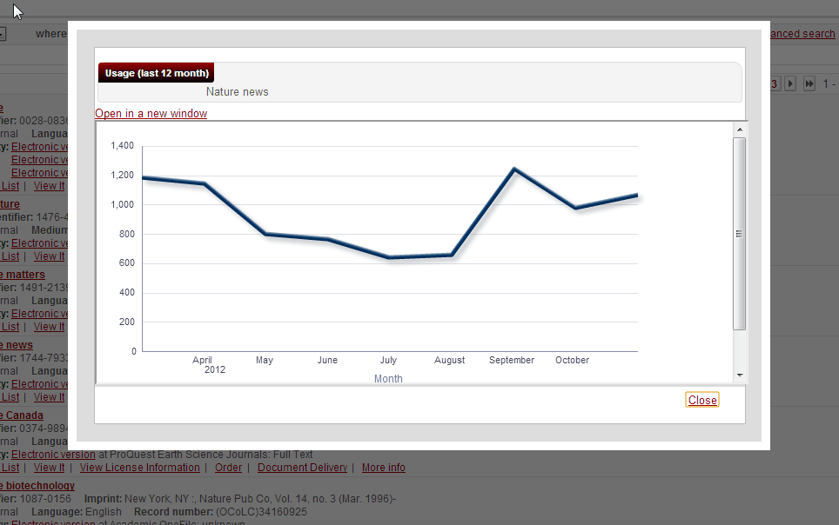
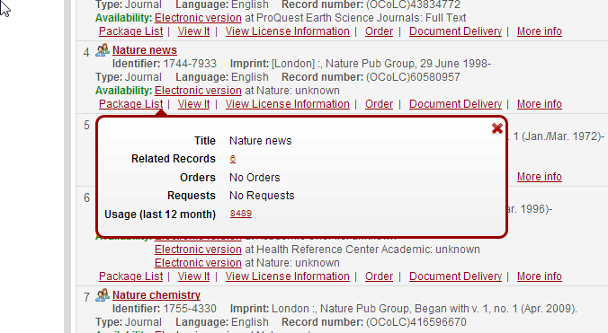
Embedded Usage

Slide 26
Real Use Case
Real Case
3,000 USD Saving in Two Days
Two days after moving into production, Fort Hays ran the Overlap Analysis report within Alma Analytics
Discovered they were double ordering a journal titles
Immediately saved 3,000 USD/Year
They expect the saving to increase significantly to tens of thousands of dollars.

Slide 27
Automated, Demand Driven Acquisitions

Slide 28
Acquisitions
Primo
Discovery
Delivery
Community zone
Alma
DATA SERVICES
Resource Management
Selection
Business Intelligence
and Analytics
Acquisitions
Cataloging
Fulfillment
Infrastructure
Cloud
Infrastructure
Security
Workflow
Engine
Open
Platform
Notes:
Alma is optimized for the needs of consortia by supporting highly flexible policies, customizable processes, joint selection, acquisitions and more.
Alma supports patron and demand-driven selection and acquisition models, offering seamless integration with Primo. These capabilities will enable the Alliance to control the exponentially increasing costs of materials by transitioning from a just-in-case to just-in-time collection development methodology – all without imposing additional overhead on library staff.
In contrast to legacy solutions, Alma utilizes an exception-based workflow model. In this model, common tasks, particularly those in acquisitions are fully automated. Staff are involved only when there are exceptions to the parameters defined by the Alliance and its members.

Slide 29
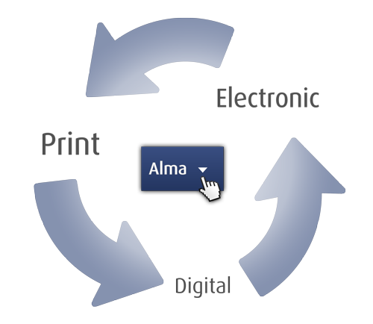
Acquisitions
Streamlined mixed resource purchasing models
Integrated claims management
Budget visibility enabling smart decision making
Unified processes for all material types
Unified processes
Review and approval steps
Various sources
Notes:
As a unified solution, streamlined acquisitions workflows are provided for all types of resources: print, electronic resources and digital collections. As mentioned previously, embedded analytics and other time saving capabilities such as integrated claims management are incorporated into each workflow.

Slide 30


Acquisitions
Purchase
requests
Reviews
and ratings
Selection
Shared
holdings
Usage
analysis
Collection
Knowledgebase
recommendations
Evaluation
Overlap
analysis
Notes:
At the beginning of the lifecycle management process with selection and evaluation, Alma provides a number of tools to assist staff including incorporating shared holdings, usage analysis, knowledgebase recommendations and more.
In addition, Ex Libris is working with materials vendors to create within Alma a selections portal that provides visibility on all selection decisions, whether they occur within Alma or an external site like GOBI.

Slide 31








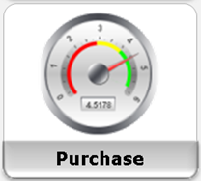
Acquisitions
Vendor A
Vendor B
Vendor C
Wizard Based Vendor EOD Profile Creation
Auto EOD Import and Processing
Rules validations
And Auto PO Generation
Track POs
and Budget
Notes:
At the beginning of the lifecycle management process with selection and evaluation, Alma provides a number of tools to assist staff including incorporating shared holdings, usage analysis, knowledgebase recommendations and more.
In addition, Ex Libris is working with materials vendors to create within Alma a selections portal that provides visibility on all selection decisions, whether they occur within Alma or an external site like GOBI.

Slide 32

Acquisitions
Vendor
Publishing
Load Candidate records
Publish to Primo
Alma
Does the rest
Notes:
Finally, I wanted to highlight our solution’s capabilities regarding Patron Driven Acquisitions. Candidate records from e-book vendors are loaded automatically into Alma and published to Primo for end-user discovery. Depending upon the access threshold that is agreed upon between the vendor and the library, titles purchased via this process are updated within Alma. The update occurs automatically via EOD records and EDI invoicing. At the end of the process, Alma automatically removes un-purchased candidate records.
Purchases via this process are specifically noted as PDA transactions for reporting and analysis.

Slide 33
Real Use Case
Real Case
260+ working hours/Year Saving on PDA Work
Boston University is saving 5+ hours per week, over 260 Hours/Year ! in staff time spent loading and activating e-book records from their vendor for a patron-driven acquisitions program.
With Alma, an import profile for the load is set up once, specifying where to retrieve the records, the frequency of load, etc.
From then on, the load runs automatically based on the library specified schedule with no staff intervention required

Slide 34
Alma Collaborative Networks

Slide 35

The Challenge
Standardize and streamline the connection points to make them seamless and reliable
Maintain local privacy and ownership of data
Support each institution’s particular workflows and standards
Maximize cooperation, integration and sharing between institutions in a network

Slide 36






Collaborative Networks - Unprecedented Collaboration
A group of institutions with relationships/collaboration in a specific library business area (e.g. collection development, resource sharing, remote storage)
Each institution can be part of many networks in multiple business areas

Slide 37



Types of Networks
Shared Catalog
  Joint acquisitions and negotiations
  ILL via broker, directly between partners
  Direct patron interaction
Cataloging
Acquisitions
Resource Sharing
Fulfillment

Slide 38


The Alma Approach
Cataloging Network

Slide 39
The Alma Approach
Resource Sharing Networks
Alma and non-Alma
partners
External broker
Notes:
How will it look whn all members are on Alma
By nature this is a wider network
Built on protocols

Slide 40
The Alma Approach
Fulfillment Networks
Walk In and Return
Direct Requesting
Notes:
Tell about the benefits
Direct Patron Interaction
Walkin
Return
Request and pickup

Slide 41
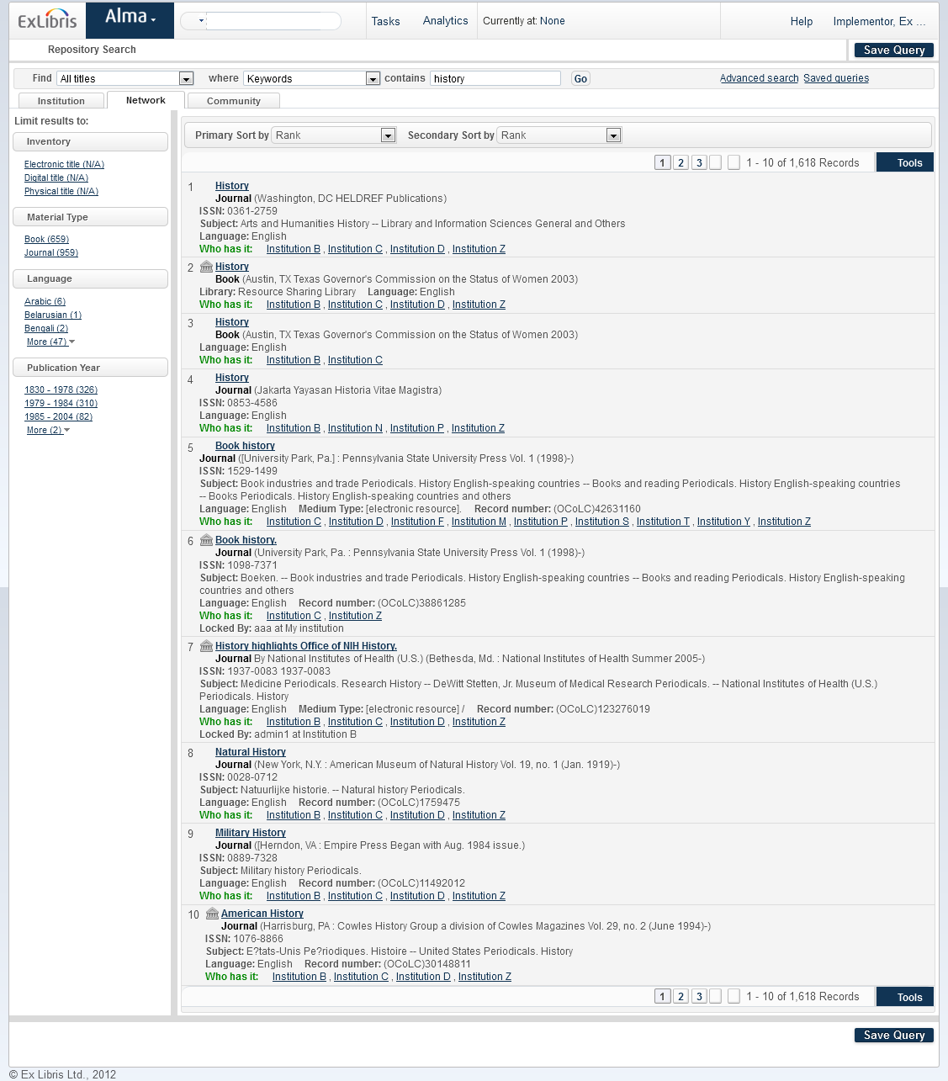
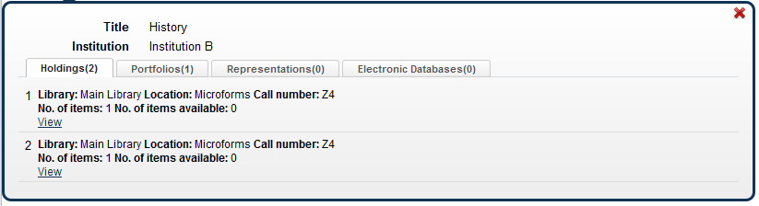
Cataloging Network: Searching

Slide 42
Rapid ROI

Slide 43
Cloud Infrastructure
Frequent, Small Updates
Periodic Releases
Lower TCO
  Bug fixes, minor enhancements
  Automatic for every customer
  No impact on daily activity
  3 times a year (spring, summer, winter)
  New features
  User requests & needs addressed in weeks / months (not years)
  No server or client upgrades
  No data migration
  Always on the latest release
Release
Release
Release
Release
Feb Mar Apr May Jun Jul Aug Sep Oct Nov Dec Jan Feb
Notes:
43
Because Alma is a Software-as-a-Service (SaaS) solution, there is no longer a need for the Alliance and its members to perform server or client upgrades or to migrate data. Essentially, once you have transitioned to Alma there are no more painful upgrades – you are always on the latest release. In addition, because Alma is continuously enhanced, we can be more responsive than ever in addressing your needs by introducing new capabilities every month with major updates occurring seasonally.

Slide 44
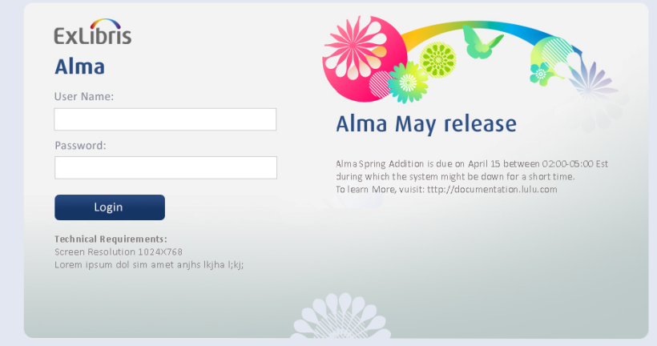
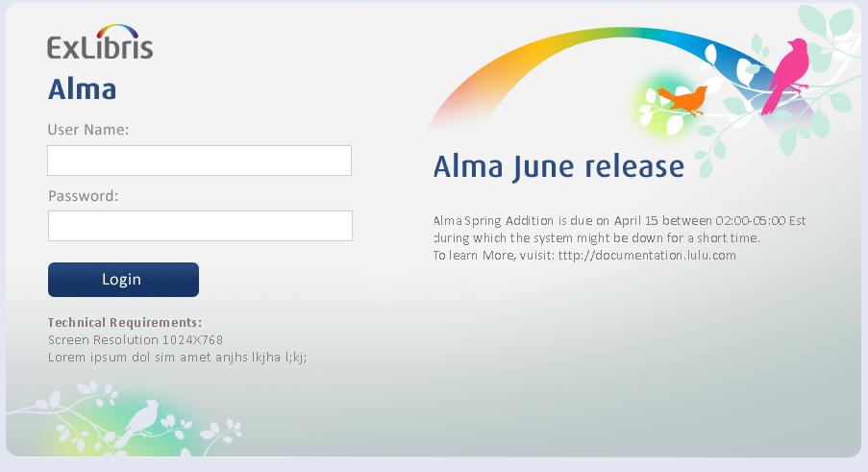
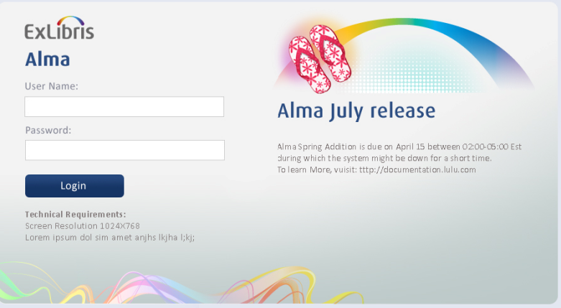
Alma Live: Continuous Enhancement

Slide 45
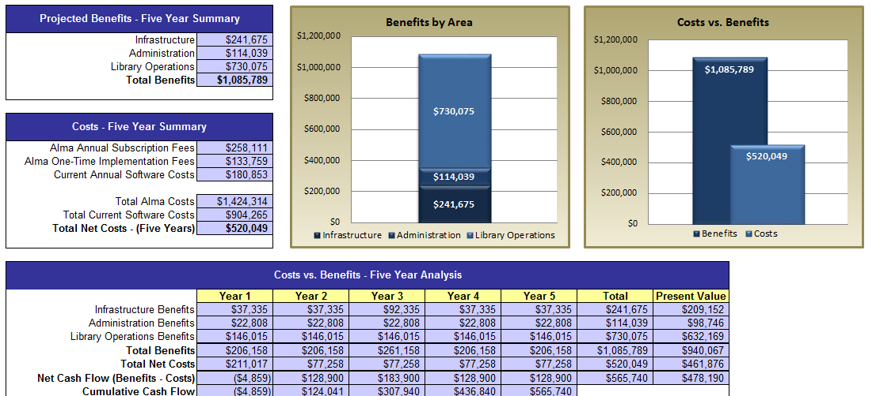
Real Use Case
Real Case
Over $500,000 saving in 5 years !

Slide 46
Alma Developers

Slide 47



Alma Developers
Course
Management
Custom Apps
Material
Vendors
Discovery &
Delivery
Student Info
Systems
Resource Sharing
Financial Systems
Alma Developers Platform
Cloud Integration Templates
Apps &
Extensions
Alma
Developers Network
Web Services,
Rest API
Publishing Services
Adapters & Interfaces
Export & Import Services
Alma Extensible Architecture

Slide 48
Alma Developers
Course
Management
Custom Apps
Material
Vendors
Discovery &
Delivery
Student Info
Systems
Resource Sharing
Financial Systems
Alma Developers Platform
Cloud Integration Templates
Apps &
Extensions
Alma
Developers Network
Web Services
Publishing Services
Adapters & Interfaces
Export & Import Services
Alma Extensible Architecture

Slide 49





Alma Developers
Alma integrations are achieved using a number of techniques
Web Services and Rest API
Publishing
Services
Data Extract
& Import
Adapters &
Interfaces
Exposing repository information to discovery tools
Leveraging Industry standards, adapters and integration interfaces
Online integrations with applications
Extending workflows
Sharing data with 3rd party solutions

Slide 50






Alma Developers
Publishing
Web Services
Data Extract & Import
Course
Management
Bursar
Systems
Finance
Systems
Mobile
Student
Info
Systems
Bulk BIB Record Manipulation
Resource
Sharing
Vendor
Systems

Slide 51
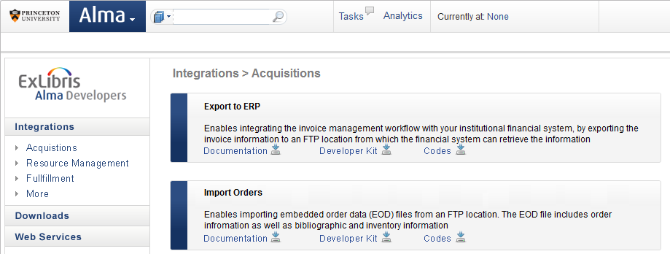
Alma Developers

Slide 52
Alma Cloud

Slide 53

Ex Libris Cloud
Cloud team led by VP Cloud Services
Co-located Computing Centers at NA, EMEA and APAC
Dedicated Security Officer
24/7 Hub
Ex Libris Alma

Slide 54















Ex Libris Cloud
Running on Industry leading Cloud Datacenter

Slide 55



Ex Libris Cloud
Ex Libris Worldwide Data Centers
Chicago
Amsterdam
DC01: 490
DC02: 1,234
DC03: 137
DC04: 790
APAC
DC05
Name: # of customers/products

Slide 56
Ex Libris Cloud
Global Facilities
Data Centers SSAE16 SOC1 and ISO-27001 certified
24/7 Personnel
Redundant Cooling / Humidity systems
Multiple Network Vendors
Redundant power systems including UPS and generators
Ex Libris Alma

Slide 57
System Management
Server, network and DBA
Application
Support and service calls
O/S management
Oracle upgrades
Back-ups
Disaster recovery
Test environments
Security infrastructure
Service packs
Version upgrades
Client deployment
Sandbox environment
Diagnostics
Implementing proposed fixes and testing solutions
Capacity planning & tuning
Logging-debugging
Firewall
Command line
Liaison between local server/app teams and Ex Libris
Configuration and customization
Logging & tracking service calls
Green = cloud managed
Purple = changed
Blue = unchanged

Slide 58


Moving to the Cloud with Peace of Mind
System Availability
Application Security
Network Security
Physical Security
Secure data-in-transit (SSL)
Data upload handling
Antivirus
Role based
access control
4
Multi Tiered
Cloud Security
1
3
2

Slide 59
Moving to the Cloud with Peace of Mind
System Availability
Application Security
Network Security
Physical Security
4
Multi Tiered
Cloud Security
1
3
2
Firewall
  Intrusion detection systems
  Proactive log file monitoring
Network segmentation
Monitoring, alerting and reporting

Slide 60
Moving to the Cloud with Peace of Mind
System Availability
Application Security
Network Security
Physical Security
4
Multi Tiered
Cloud Security
1
24x7 watch & video
Biometric access
control
Physical access activities logged and monitored
Video recording
3
2

Slide 61
Moving to the Cloud with Peace of Mind
Penetration testing
Dedicated Operation Team
Data Snapshots
System Availability
Application Security
Network Security
Physical Security
4
Multi Tiered
Cloud Security
1
3
2

Slide 62
How is Alma Better than other solutions?
Single Unified Solution
Depth of Functionality
Automated Workflows
Single solution for Print, Electronic and Digital
Best-in-class functionality depth
Exception-based workflows minimizes staff involvement
Analytics
Driven
Unique and Shared Data
Open & Interoperable
Data-driven
decision making
Hybrid model – institution & community zone
Integrations, Extensions & Developers Platform
Multi-Format Support
Highly
Configurable
Collaborative Networks
Multi-format metadata & inventory management
Configurable to your business needs
Unprecedented Collaboration

Slide 63
Thank You !

